Slide 2
MMA841 Operations Management Inventory Management
Master of Management Analytics – Session 4
Geoff Pond
Notes:
An example of a title page with more specific program details in the title

Slide 3
Introduction
Virtually all operations need to purchase some inventory of some type, including service operations:
Manufacturing/Production require raw materials
Retail sector purchases inventory for resale
Hospitality sector requires supplied food/beverages
Medical sector requires consumable supplies (e.g., medications)
Airlines and repair depots stock spare parts
Airlines also “stock” passengers (another form of inventory)
…

Slide 4
Introduction
The ensuing question is, generally, “how much inventory should I stock”?
How many spare parts should I stock?
How many items of a specific SKU should a retailer stock locally – or in a regional warehouse?
How many tickets should I sell for a flight, beyond the number of seats on the aircraft?
How many railcars should be moved to a specific railyard in anticipation of future demand there?

Slide 5
Approach #1 – Expected Value Approach
In real-life, demand is typically stochastic (especially in service operations) and so, at best, we can develop a probabilistic demand distribution but will not know the future demand with certainty.
A naïve approach to the problem would be to simply stock sufficient inventory to meet the expected demand (or average demand).

Slide 6
Approach #2 – Targeted Service Level
Some applications are risk adverse (e.g., medical sector) and will tolerate limited (if any) chance of a “stock-out”.
Step 1A: collect empirical data of historical demand
Step 1B: develop a theoretical demand distribution
Step 2: based on how much of the demand distribution you want to cover, identify the corresponding order volume

Slide 7
Approach #2 – Targeted Service Level
Example 1
A frequency table for historical weekly demand of vehicle rentals at a local dealership is as follows:
Suppose I accept running out of vehicles 10% of the time, how many vehicles should I ensure are available to rent at the local dealer?
0-5 | 5-10 | 10-15 | 15-20 | 20-25
3 | 11 | 14 | 10 | 2

Slide 8
Approach #2 – Targeted Service Level
0-5 | 5-10 | 10-15 | 15-20 | 20-25
3 | 11 | 14 | 10 | 2
Suppose I accept running out of vehicles 10% of the time, how many vehicles should I ensure are available to rent at the local dealer?
If I accept being out-of-stock 10% of the time, then I must have sufficient stock 90% of the time.
In total, the above table counts 40 weeks of data. The 90th percentile represents the 36th case.

Slide 9
Approach #2 – Targeted Service Level
Demand: | 0-5 | 5-10 | 10-15 | 15-20 | 20-25
Frequency: | 3 | 11 | 14 | 10 | 2
Cumulative Frequency: | 3 | 14 | 28 | 38 | 40
The 36th case falls into this “bin”
To ensure we meet the demand, we would stock 20 vehicles (the upper limit of the bin)

Slide 10
Approach #2 – Targeted Service Level
Example 2
The car dealer posits that demand is normally distributed with a mean demand of 20 rentals per week and standard deviation of 3 vehicles per week.
In Excel,
“=NORM.INV(probability, mean, standard deviation)”
“=NORM.INV(.9,20,3)” yields 23.8
(so we would stock 24 vehicles)

Slide 11
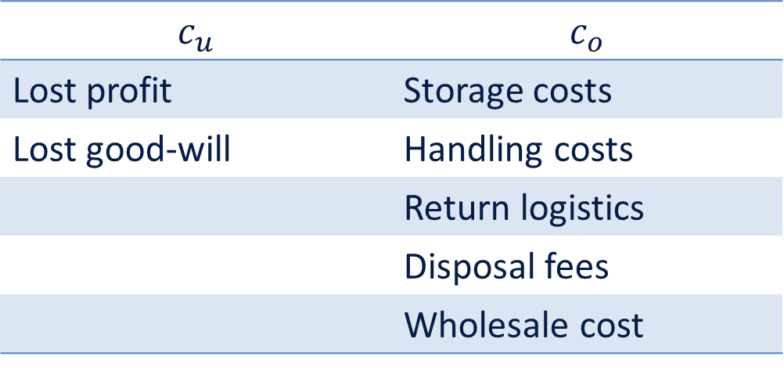

Approach #3: Minimizing Inventory Costs
From the perspective of inventory management, we maximize profit by minimizing our total costs. We have costs associated with under-estimating the demand ($c_{u}$) and we have costs associated with over-estimating the demand ($c_{o}$).
$$c_{u}$$ | $$c_{o}$$
Lost profit | Storage costs
Lost good-will | Handling costs
 | Return logistics
 | Disposal fees
 | Wholesale cost

Slide 12
Approach #3: Minimizing Inventory Costs
Consider a problem where our unit margin is $12 but our holding costs are $4 for every unsold unit. Further, the expected demand is 50 units with standard deviation of 10 units. How many units should we order?
Should I just order enough units to meet the expected demand?
Why or why not?

Slide 13
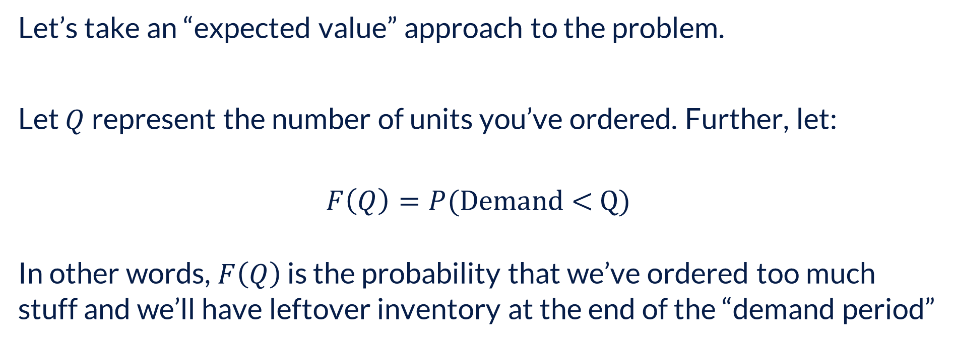
Approach #3: Minimizing Inventory Costs
Let’s take an “expected value” approach to the problem.
Let $Q$ represent the number of units you’ve ordered. Further, let:
$$F\left(Q\right)=P(\text{Demand}\text{ < }\text{Q})$$
In other words, $F\left(Q\right)$ is the probability that we’ve ordered too much stuff and we’ll have leftover inventory at the end of the “demand period”

Slide 14
Approach #3: Minimizing Inventory Costs
Let’s take an “expected value” approach to the problem.
Let $Q$ represent the number of units you’ve ordered. Further, let:
$$F\left(Q\right)=P(\text{Demand}\text{ < }\text{Q})$$
In other words, $F\left(Q\right)$ is the probability that we’ve ordered too much stuff and we’ll have leftover inventory at the end of the “demand period”

Slide 15
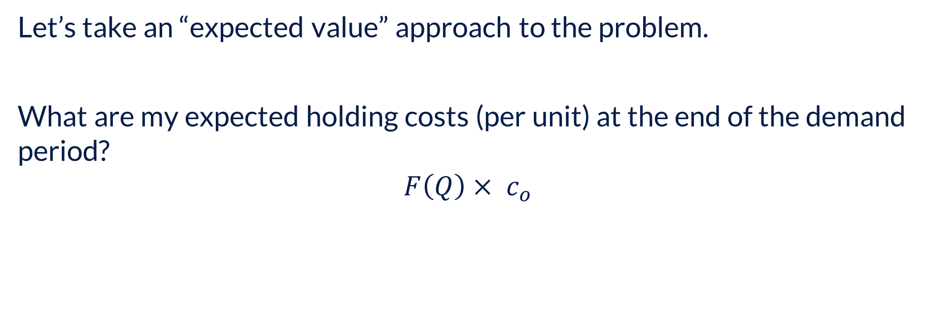
Approach #3: Minimizing Inventory Costs
Let’s take an “expected value” approach to the problem.
What are my expected holding costs (per unit) at the end of the demand period?
$$F\left(Q\right)× c_{o}$$

Slide 16
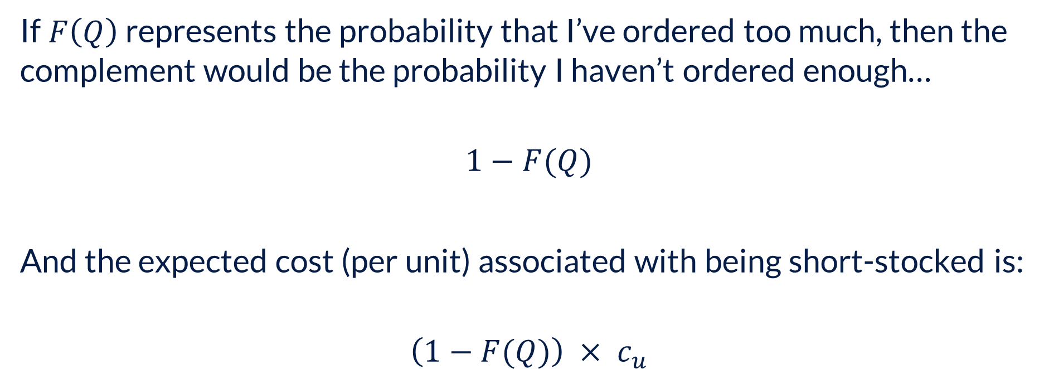
Approach #3: Minimizing Inventory Costs
If$F\left(Q\right)$ represents the probability that I’ve ordered too much, then the complement would be the probability I haven’t ordered enough…
$$1−F(Q)$$
And the expected cost (per unit) associated with being short-stocked is:
$$\left(1−F(Q)\right) × c_{u}$$

Slide 17
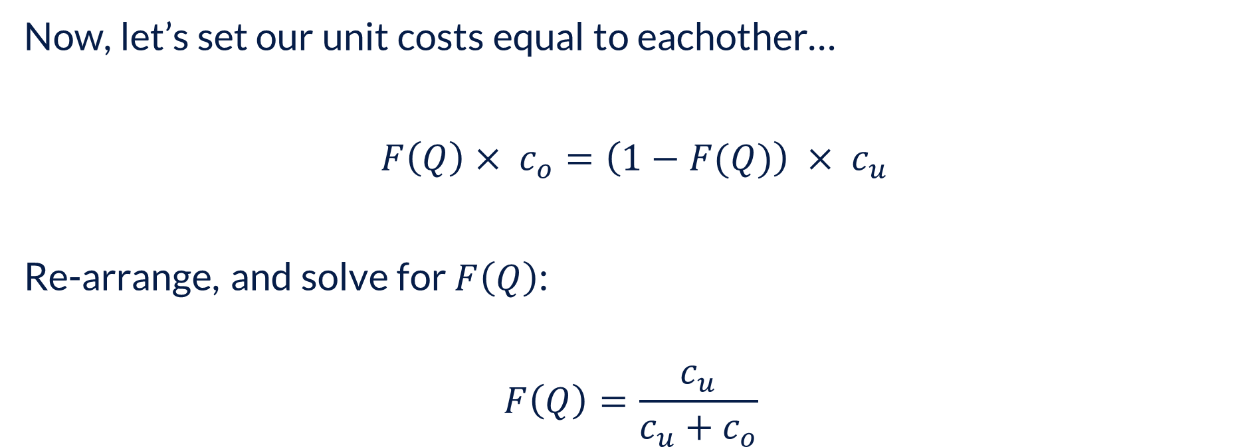
Approach #3: Minimizing Inventory Costs
Now, let’s set our unit costs equal to eachother…
$F\left(Q\right)× c_{o}=\left(1−F(Q)\right) × c_{u}$
Re-arrange, and solve for $F\left(Q\right)$:
$$F\left(Q\right)=\frac{c_{u}}{c_{u}+c_{o}}$$

Slide 18

Approach #3: Minimizing Inventory Costs
For our specific problem,
$$F\left(Q\right)=\frac{c_{u}}{c_{u}+c_{o}}=\frac{12}{12+4}=0.75→z=0.67449$$
$$Q=μ+zσ \\ =50+\left(0.67449\right)\left(10\right) \\ =56.7449 \text{units}$$

Slide 19
Approach #3: Minimizing Inventory Costs

Slide 20
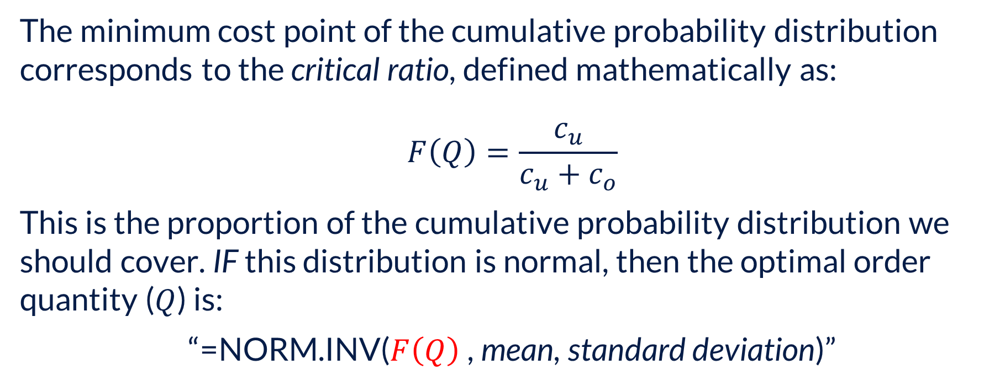
Approach #3: Minimizing Inventory Costs
The minimum cost point of the cumulative probability distribution corresponds to the critical ratio, defined mathematically as:
$$F\left(Q\right)=\frac{c_{u}}{c_{u}+c_{o}}$$
This is the proportion of the cumulative probability distribution we should cover. IF this distribution is normal, then the optimal order quantity ($Q$) is:
“=NORM.INV($F\left(Q\right)$ , mean, standard deviation)”

Slide 21
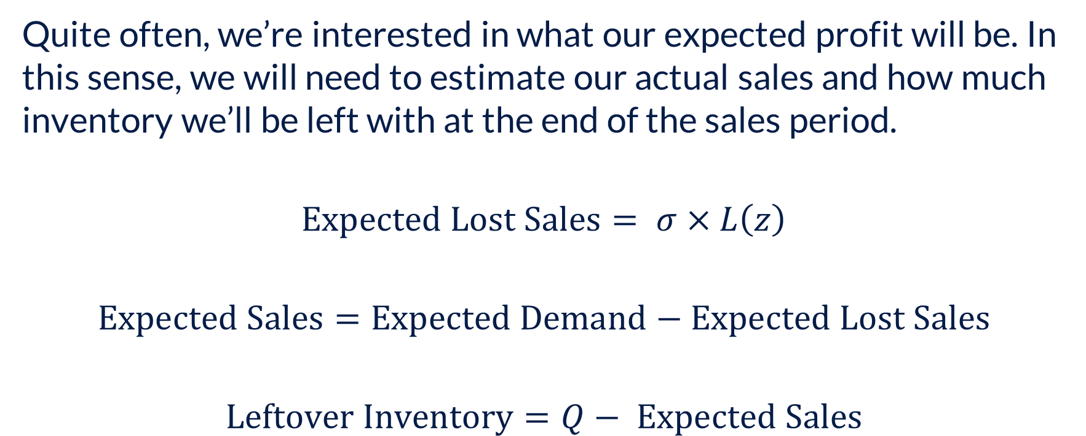
Approach #3: Minimizing Inventory Costs
Quite often, we’re interested in what our expected profit will be. In this sense, we will need to estimate our actual sales and how much inventory we’ll be left with at the end of the sales period.
$$\text{Expected} \text{Lost} \text{Sales}= σ×L\left(z\right)$$
$$\text{Expected} \text{Sales}=\text{Expected} \text{Demand}−\text{Expected} \text{Lost} \text{Sales}$$
$$\text{Leftover} \text{Inventory}=Q− \text{Expected} \text{Sales}$$

Slide 22
Approach #3: Minimizing Inventory Costs
Example
Teddy Bower is an outdoor clothing and accessories chain that purchases a line of parkas at $10 each from its Asian supplier, TeddySports. Unfortunately, at the time of order placement, demand is still uncertain. Teddy Bower forecasts that its demand is normally distributed with mean of 2,100 and standard deviation of 1,200. Teddy Bower sells these parkas at $22 each. Unsold parkas have little salvage value; Teddy Bower simply gives them away to a charity.
a) How many parkas should Teddy Bower buy from TeddySports to maximize expected profit?
b) If Teddy Bower wishes to ensure a 98.5 percent in-stock probability, how many parkas should it order?
For parts c and d, assume Teddy Bower orders 3,000 parkas.
c) Evaluate Teddy Bower's expected profit.
d) Evaluate Teddy Bower's stockout probability.

